Slide 1
Gamification world
Gamification model and/or framework
explain
Game design process
Game world
theoretical foundation/ justification in
Game design models
introduce / define
explain
Game events
Non-game world
Theories/models of motivation and human behavior
produce / induce changes in the users state
explain
Non-game events

Slide 2
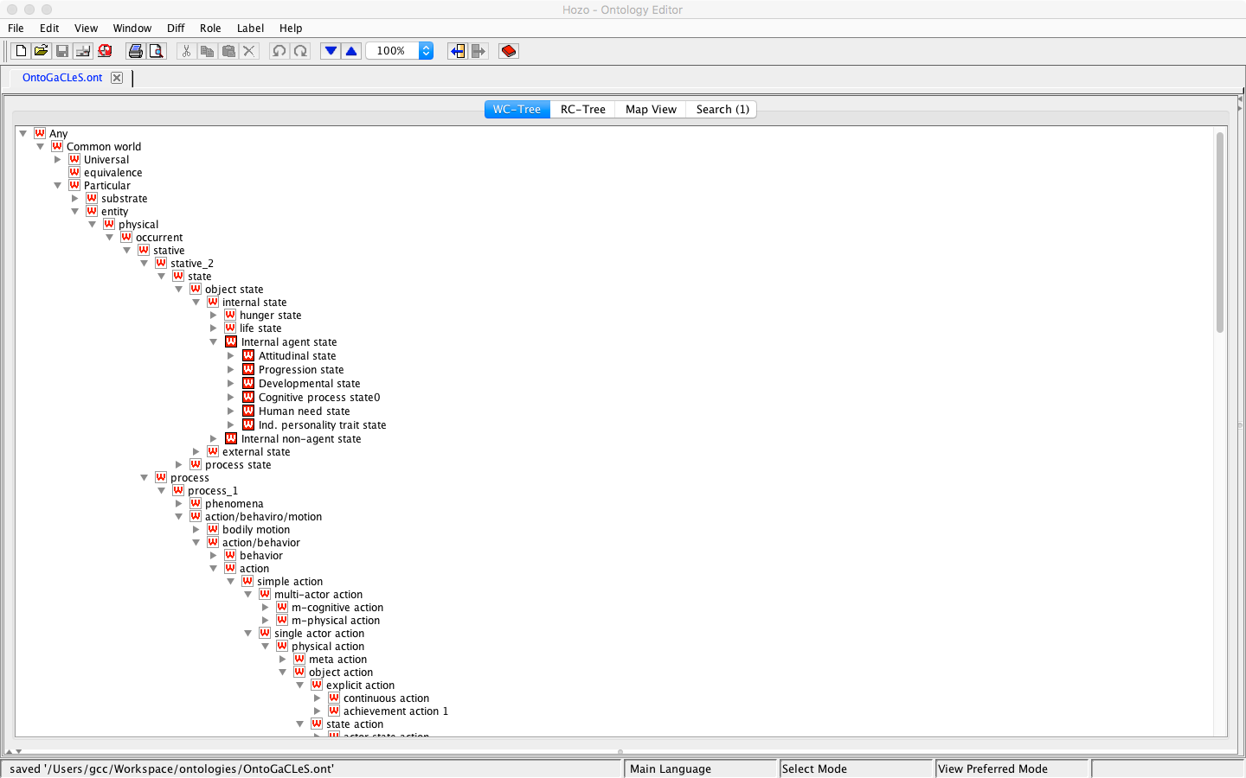
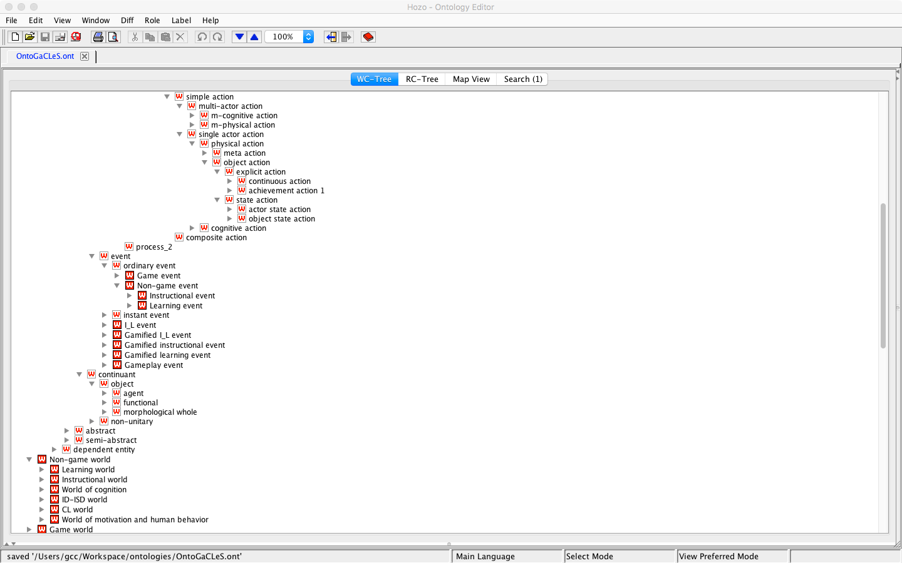
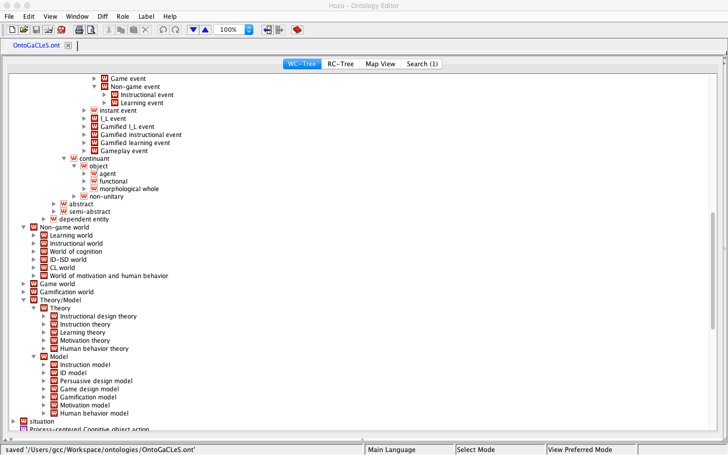

Slide 3
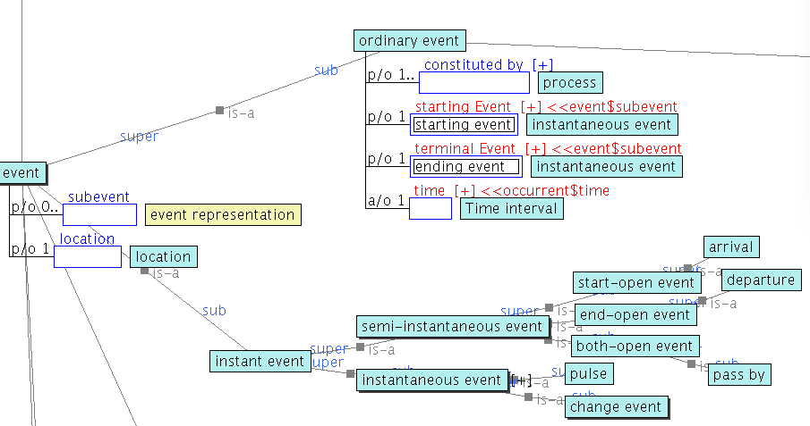
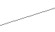
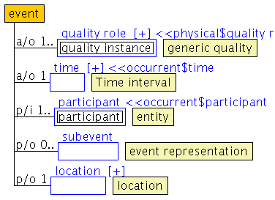

Slide 4
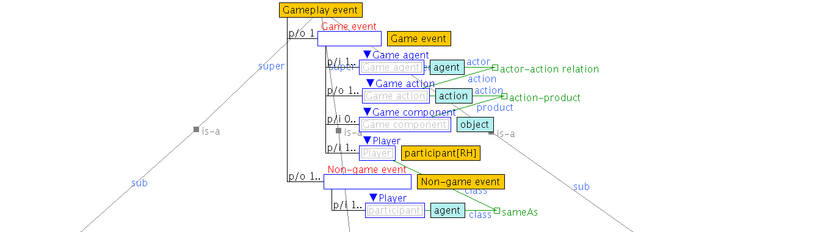
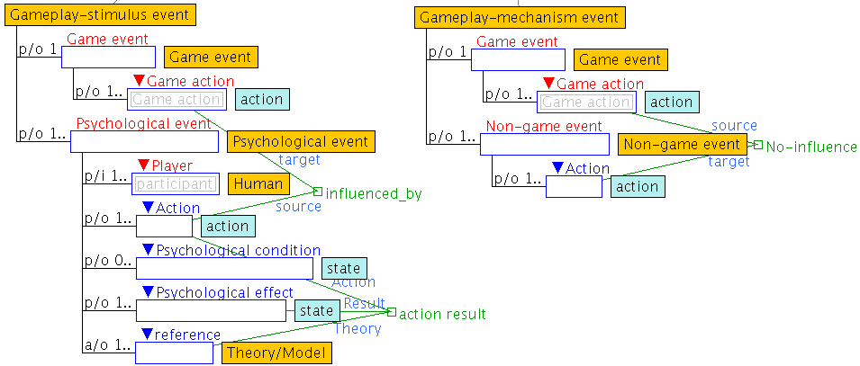
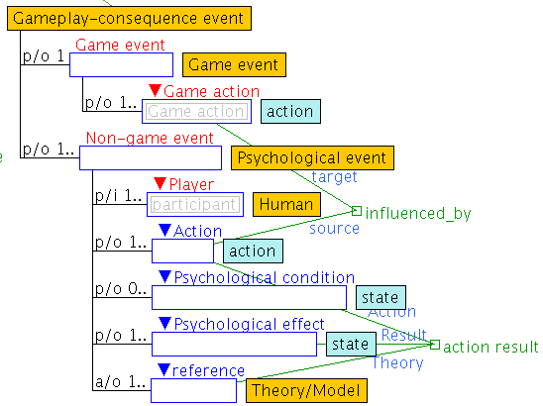

Slide 5
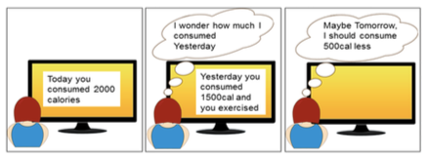
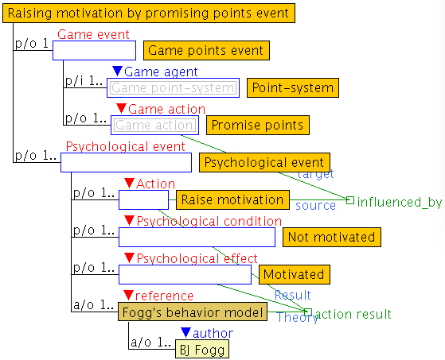
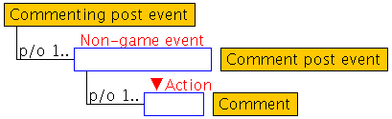
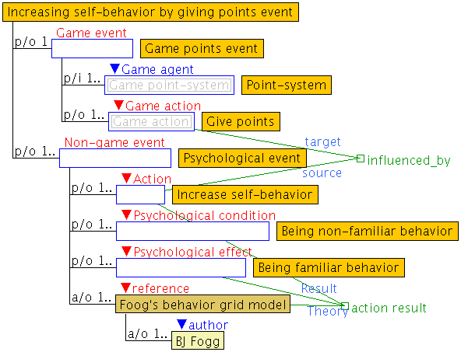
Current points: 50 points
+100 points to comment a post
Current points:
150 points
Raise
motivation
Increase self-behavior

Slide 6
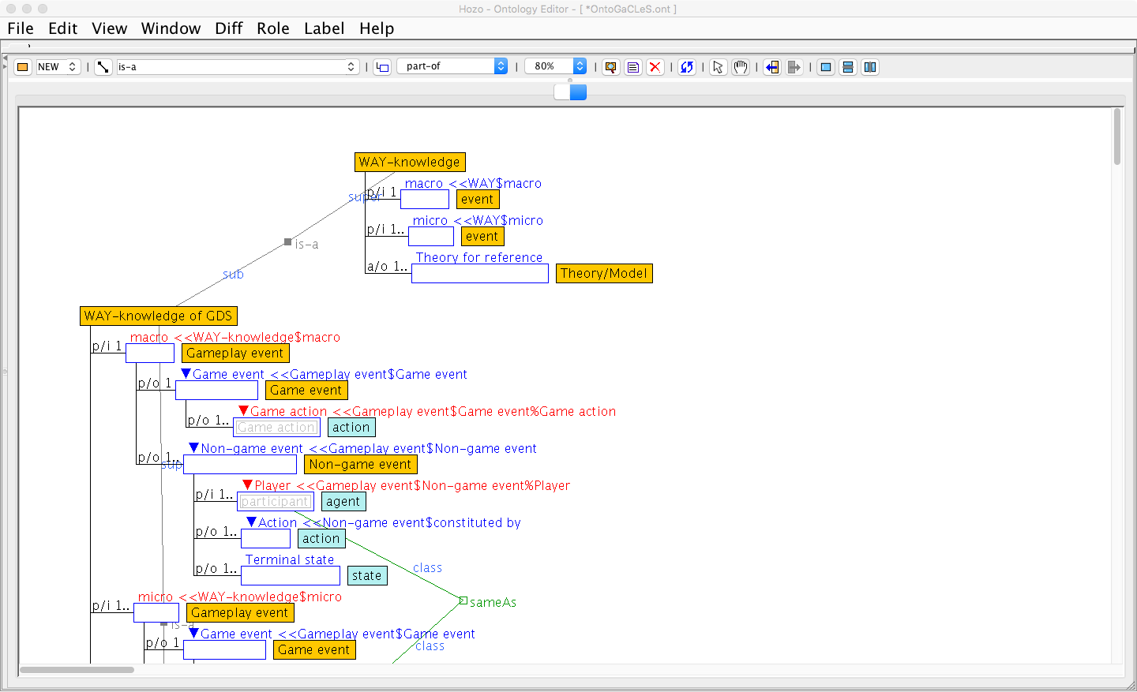
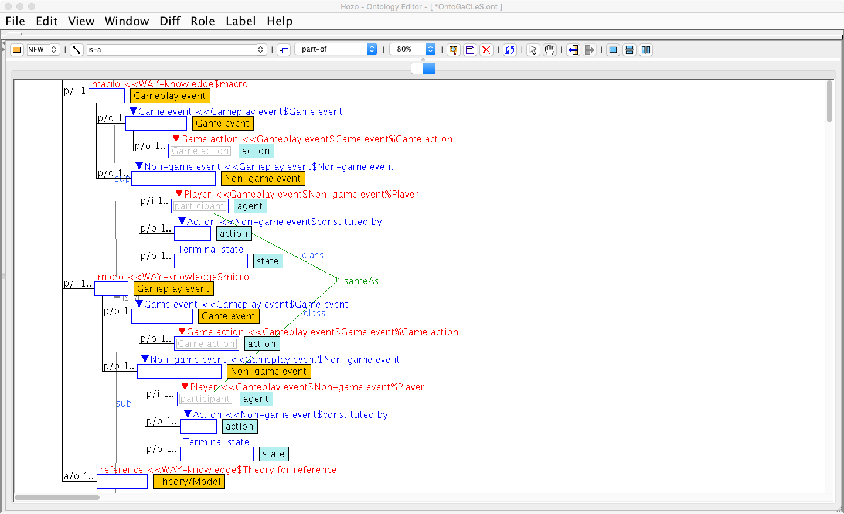
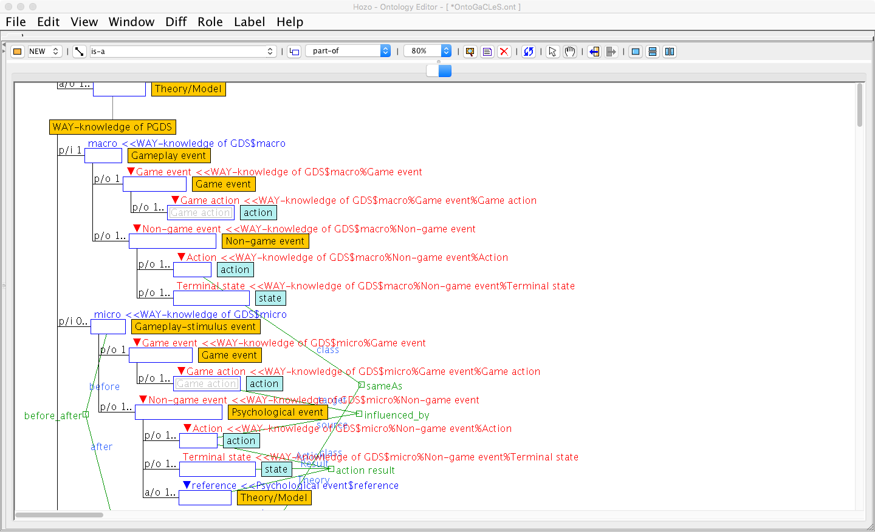
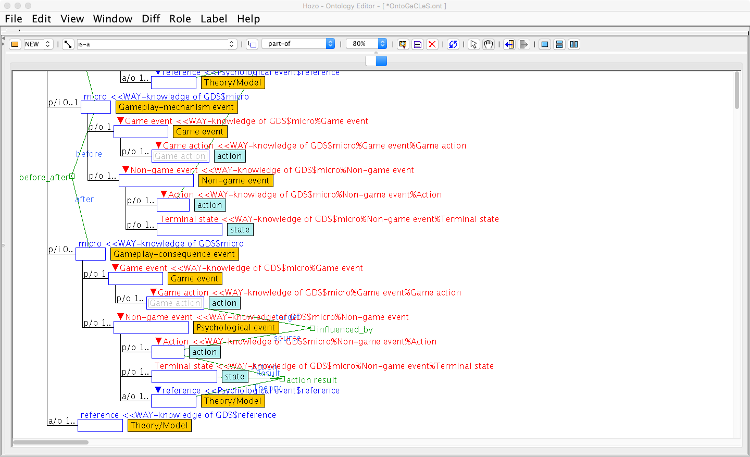
Game action
Action
Terminal state
Gameplay event
WAY-knowledge of GDS
Game action
Action
Terminal state
Game action
Action
Terminal state
Gameplay event
Gameplay event
Game action
Action
Terminal state
Gameplay event
WAY-knowledge of PGDS
Game action
Action
Terminal state
Game action
Action
Terminal state
Game action
Action
Terminal state
Gameplay-stimulus event
Gameplay-mechanism event
Gameplay-consequence event

Slide 7
WAY-knowledge of GDS
is-a
is-a
WAY-knowledge of PGDS
is-a
is-a
is-a
PGDS for primary task
is-a
PGDS for social support
PGDS for system credibility
is-a
is-a
is-a
is-a
PGDS for dialogue
is-a
is-a
is-a
is-a
is-a
Praise strategy
is-a
Reward strategy
Suggestion strategy
is-a
is-a
is-a
is-a
is-a
is-a
is-a
Action
Motivated, Being familiar behavior
Action
Being attentive
Reward strategy to be motivated and to make familiar behavior based on PSD
Suggestion strategy to be attentive based on PSD
Promise reward
Raise motivation
Motivated
Await
Action
Give reward
Increase self-behavior
Being familiar behavior
Give suggestion
Focus attention
Being attentive
Await
Action
Gameplay-stimulus
Gameplay-mechanics
Gameplay-consequence
Gameplay-stimulus
Gameplay-mechanics
decompose
decompose
Give reward
Action
Give reward
Action
Give suggestion
Action
Give suggestion
Action
Give reward strategy by points
Give reward strategy by virtual items
Give suggestion strategy by progress bar
Give suggestion strategy by level
Give points
Receive points
Has received points
Give virtual items
Receive virtual items
Has received virtual items
Show cond. to achieve next level
View cond. of next level
Has known cond. to achieve next level
Highlight next step
View next step
Has known next step

Slide 8
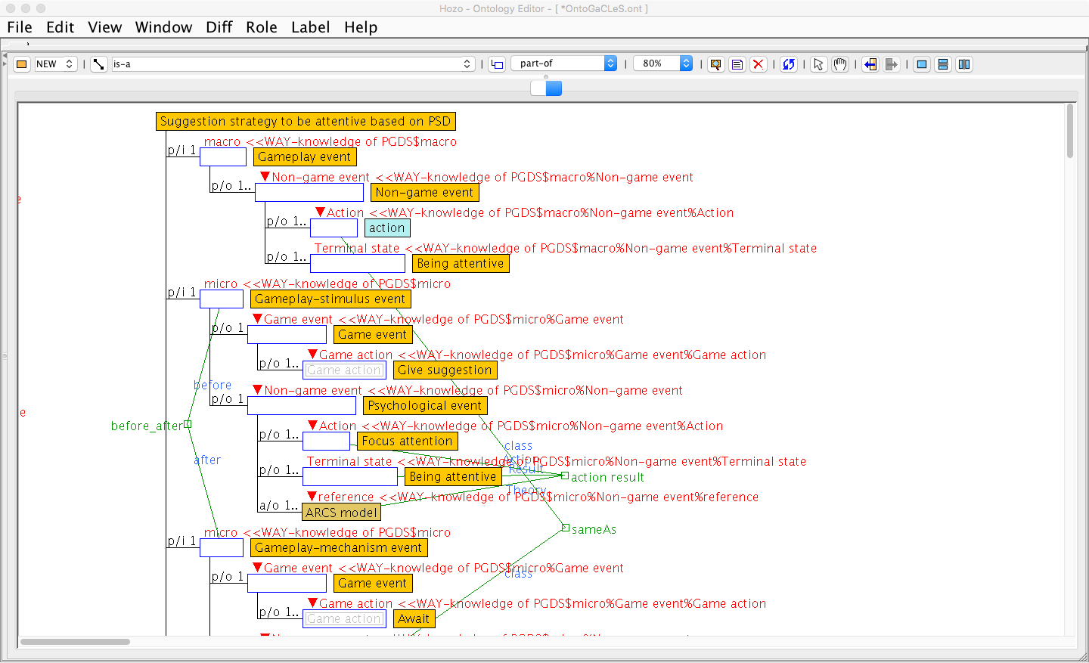
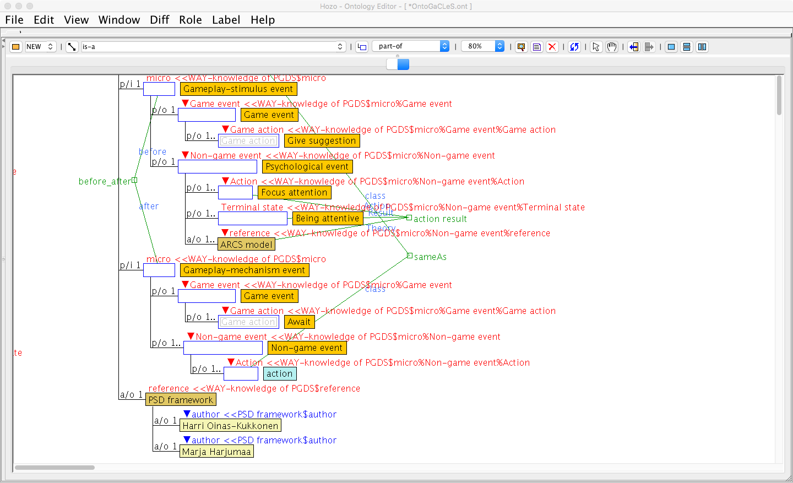

Slide 9
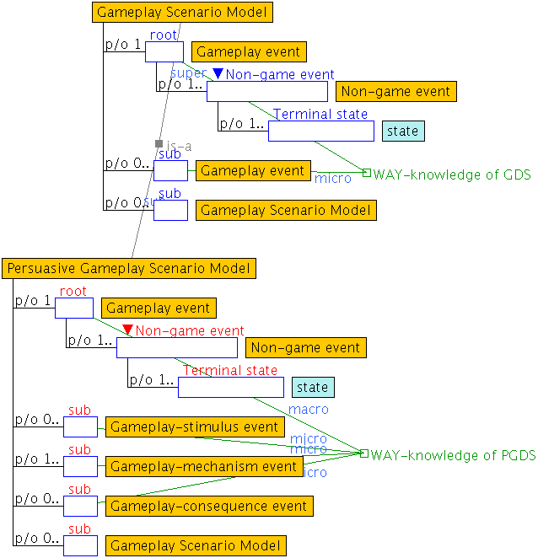
Game action
Action
Terminal state
Gameplay event
WAY-knowledge of PGDS
Game action
Action
Terminal state
Game action
Action
Terminal state
Game action
Action
Terminal state
Gameplay-stimulus event
Gameplay-mechanism event
Gameplay-consequence event
WAY-knowledge of GDS
Game action
Action
Terminal state
WAY-knowledge of PGDS
Game action
Action
Terminal state
Game action
Action
Terminal state
Game action
Action
Terminal state
Gameplay-stimulus event
Gameplay-mechanism event
Gameplay-consequence event

Slide 10
[ ]
Inform
Motivated, Being familiar behavior
Reward strategy to be motivated and to make familiar behavior based on PSD
Promise reward
Raise motivation
Motivated
Await
Inform
Being attentive
Give reward
Increase self-behavior
Being familiar behavior
Gameplay-stimulus
Gameplay-mechanics
Gameplay-consequence
Promise reward strategy by points
Suggestion strategy to be attentive based on PSD
Give reward strategy by points
Promise points
Receive promise of points
Has received the promise of points
Give points
Receive points
Has received points
Give suggestion
Focus attention
Being attentive
Await
Inform
Gameplay-stimulus
Gameplay-mechanics
Give suggestion strategy by level
Show cond. to achieve next level
View cond. of next level
Has known cond. to achieve next level

Slide 11
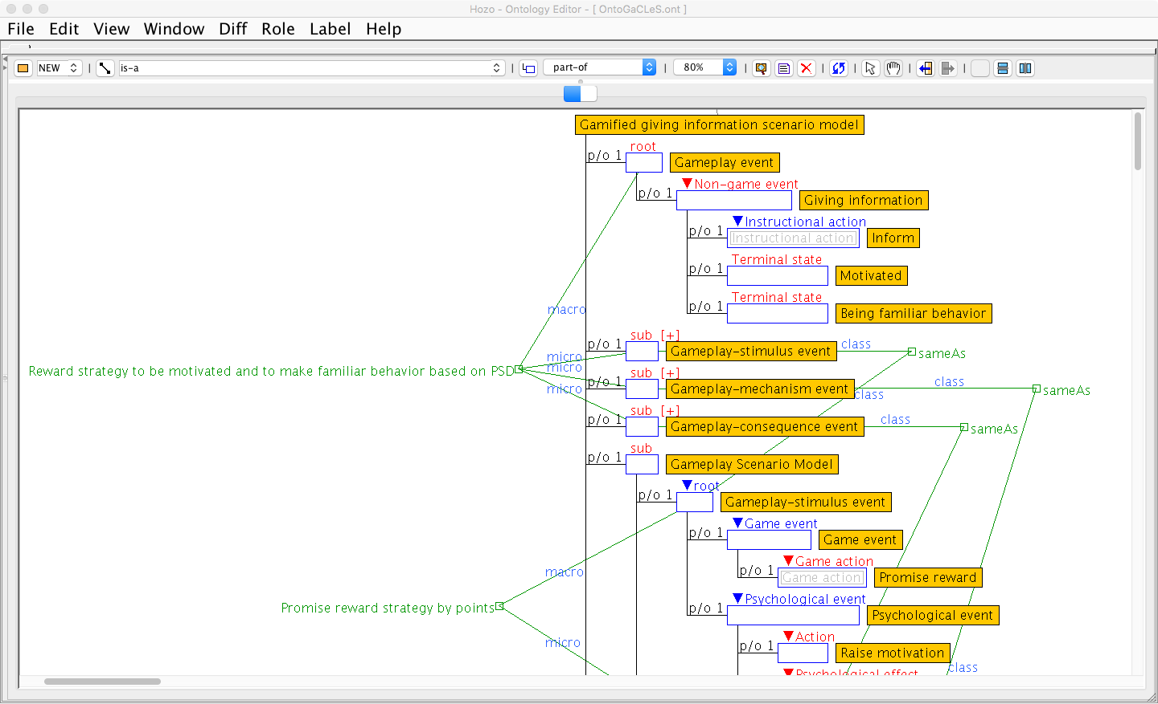
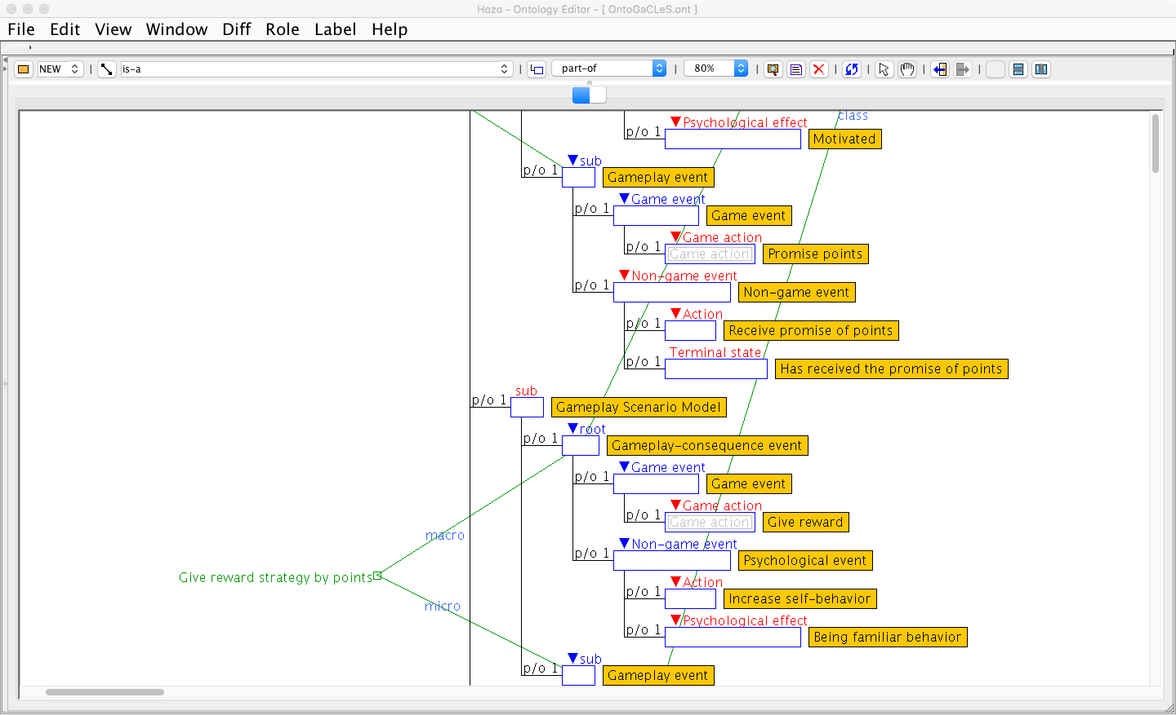
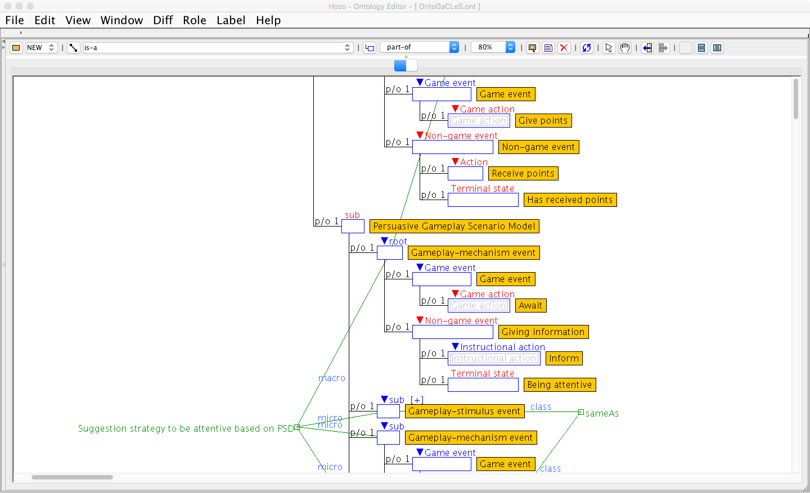
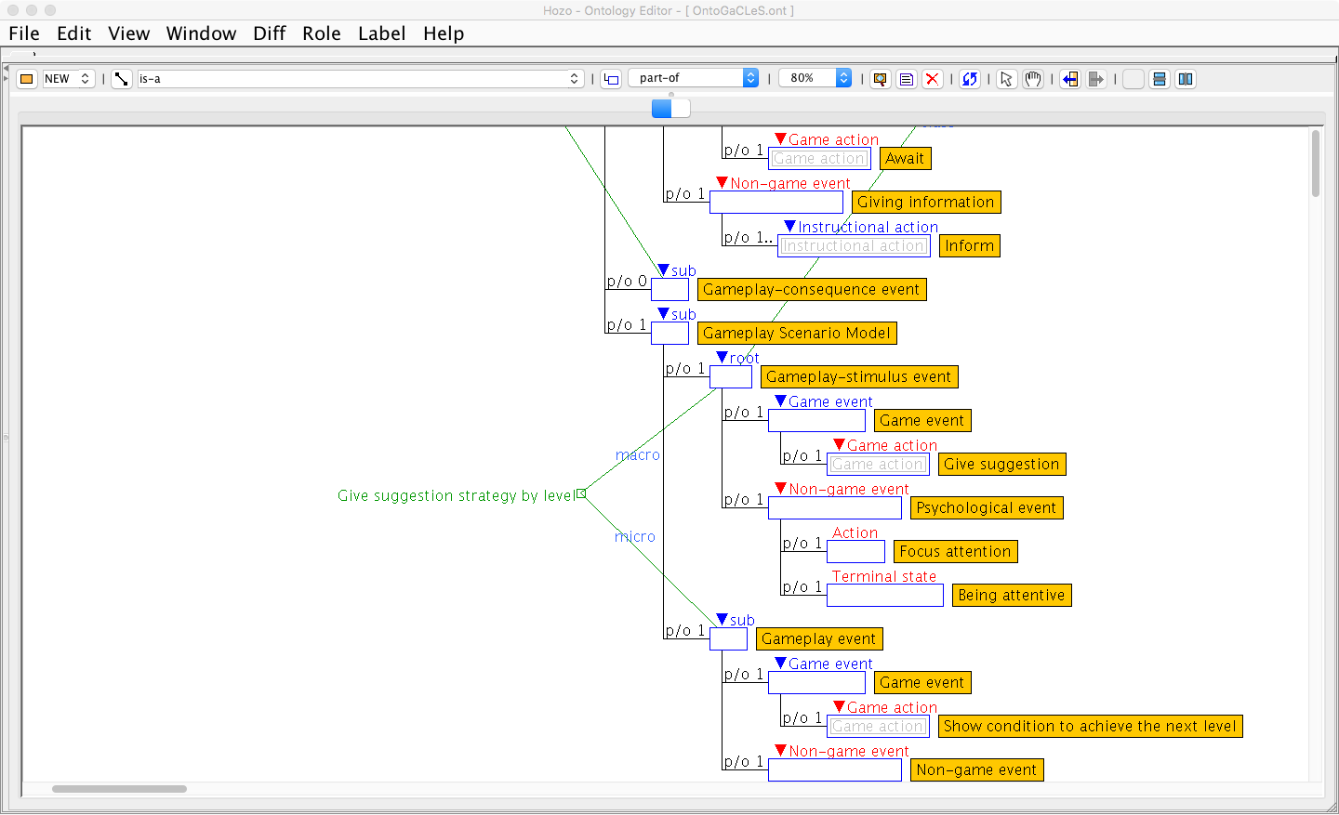
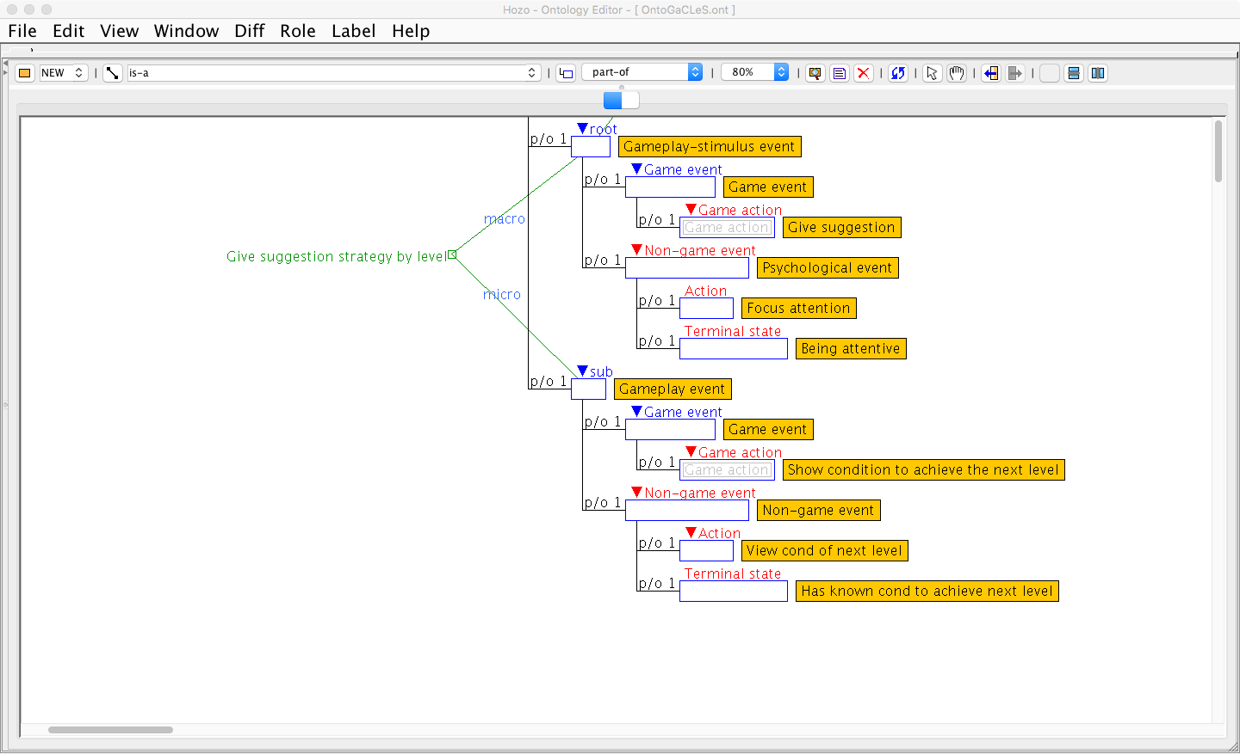

Slide 12
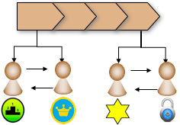







CL Game Dynamic (L_{A,}L_{B})
I-gameplay strategy (L_{A})
Interaction Pattern(L_{A},L_{B})
I-gameplay strategy (L_{B})
Application of Persuasive Game Design Strategies
L_{A}
L_{B}
L_{A}
L_{B}
L_{A}
L_{B}
L_{A}
L_{B}
CL Game Dynamic (L_{C,}L_{B})
L_{c}
Interaction Pattern(L_{C},L_{B})
L_{c}
CL process (L_{A},L_{B},L_{C})
CL Gameplay (L_{A},L_{B},L_{C})
I-gameplay strategy (L_{C})
Interaction Pattern(L_{A},L_{C})
L_{C}
L_{B}
L_{C}
L_{B}
CL Game Dynamic (L_{A,}L_{C})
Application of Persuasive Game Design Strategies
Gamified I_L event (L_{A,}L_{C})
Player roles
L_{A}
L_{C}
Game elements
I_L event (L_{A,}L_{C})
L_{A}
L_{C}
L_{A}
L_{C}

Slide 13
Game action
Instructional action
Terminal state
WAY-knowledge of PGDS
Game action
Psychological process
Terminal state
Game action
Instructional action
Terminal state
Game action
Psychological process
Terminal state
Gameplay-stimulus
Gameplay-mechanics
Gameplay-consequence
Gameplay Scenario Model 1
Gameplay Scenario Model 2
WAY-knowledge of GDS
WAY-knowledge of GDS
Game action
Action
Terminal state
Game action
Instructional action
Terminal state
Game action
Action
Terminal state
WAY-knowledge of PGDS
Game action
Psychological process
Terminal state
Game action
Instructional action
Terminal state
Game action
Psychological process
Terminal state
Game stimulus event
Game consequence event
Game stimulus event
Game consequence event
Gameplay-stimulus
Gameplay-mechanics
Gameplay-consequence
Game agent
Game agent
Game agent
Game agent
G₁
G₂
G₃
G₄
Changes in game elements
Changes in game elements
Changes in game elements
Changes in game elements
WAY-knowledge of GDS
WAY-knowledge of GDS
Game stimulus
Game effect
Game stimulus
Game effect
Game world
Game action
Action
Terminal state
Game action
Action
Terminal state
Non-game world
Instructional event
Learning event
Instructor
persuade L_{B} to perform
Learner
L_{A}
Learning action
L_{B}
I-mot goal
Instructional action
I-mot goal
allow L_{B} to attain
Gamified Instructional event
Gamified Learning event

Slide 14
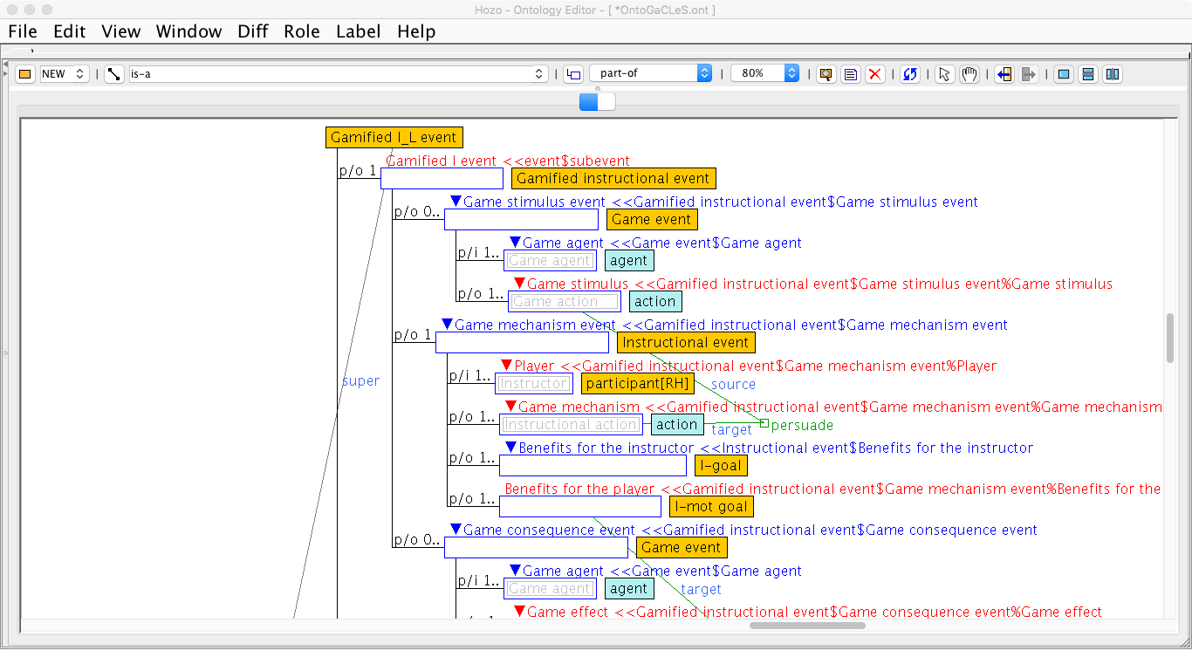
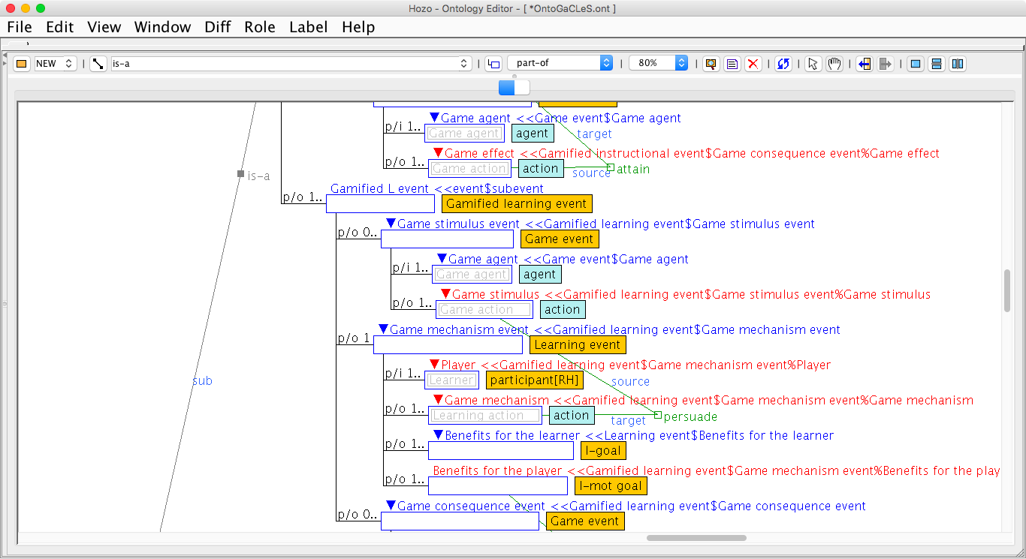
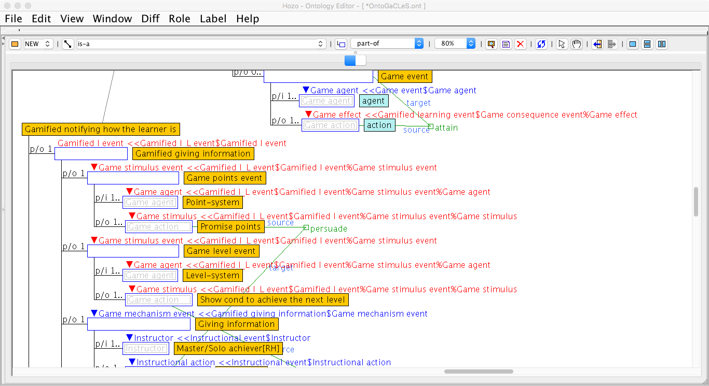
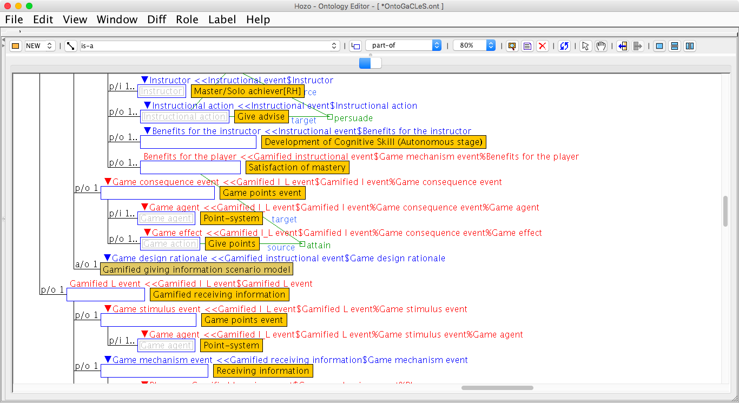
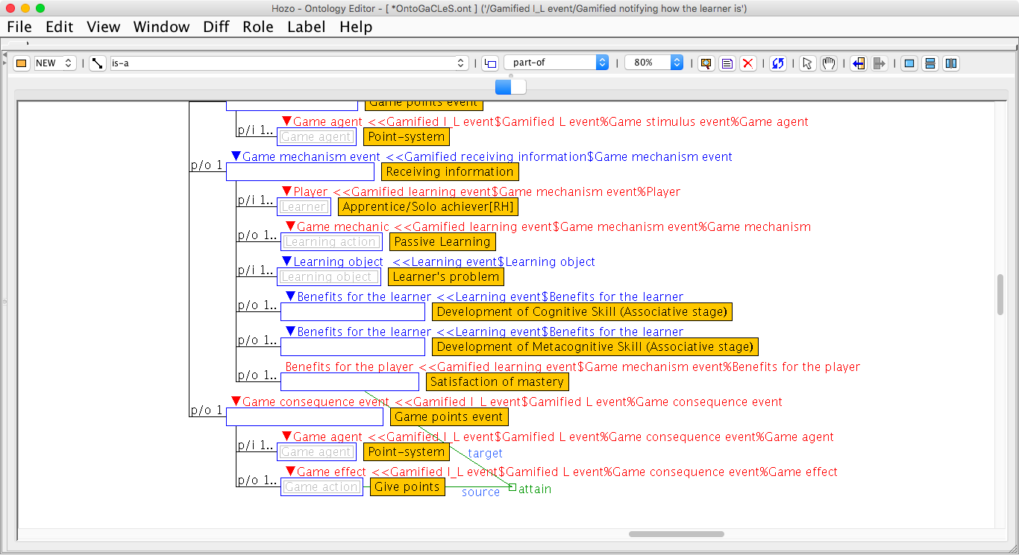

Slide 15
Gameplay Scenario Model 1
[ ]
Give advise
Motivated, Being familiar behavior
Gameplay Scenario Model 2
Reward strategy to be motivated and to make familiar behavior based on PSD
[ ]
Passive learning
Motivated, Being familiar behavior
Promise reward
Raise motivation
Motivated
Await
Give advise
Being attentive
Give reward
Increase self-behavior
Being familiar behavior
Reward strategy to be motivated and to make familiar behavior based on PSD
Gameplay-stimulus
Gameplay-mechanics
Gameplay-consequence
Promise reward strategy by points
Suggestion strategy to be attentive based on PSD
Give reward strategy by points
Promise reward
Raise motivation
Motivated
Await
Passive learning
Give reward
Increase self-behavior
Being familiar behavior
Promise points
Receive promise of points
Has received the promise of points
Gameplay-stimulus
Gameplay-mechanics
Gameplay-consequence
Give points
Receive points
Has received points
Give suggestion
Focus attention
Being attentive
Await
Give advise
Promise reward strategy by points
Give reward strategy by points
Promise points
Receive promise of points
Has received the promise of points
Gameplay-stimulus
Gameplay-mechanics
Give points
Receive points
Has received points
Give suggestion strategy by level
Show cond. to achieve next level
View cond. of next level
Has known cond. to achieve next level
Game stimulus event
Game stimulus event
Game consequence event
Game stimulus event
Game consequence event
Point-system
Level-system
Point-system
Point-system
Point-system
G₁
G₁
G₂
G₃
G₄
Changes in game elements
Changes in game elements
Changes in game elements
Changes in game elements
Changes in game elements
Promise points
Show cond. to achieve next level
Give points
Promise points
Give points
Game world
allow L_{A} to attain
Non-game world
Instructional event
Learning event
persuade L_{B} to perform
Master/Solo achiever
Apprentice/Solo achiever
Passive learning
L_{A}
L_{B}
allow L_{B} to attain
Satisfaction of mastery
Give advice
Satisfaction of mastery
persuade L_{A} to perform
Gamified Instructional event
Gamified Learning event

Slide 16





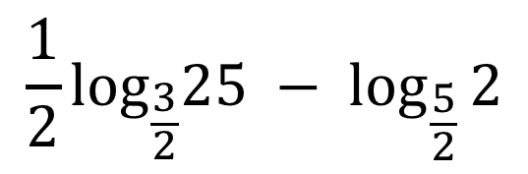
 | Game stimulus event | Game mechanism event | Game consequence event
Master/ Solo achiever [Role Holder]
Apprentice/ Solo achiever [Role Holder]
(1A)
(3)
Point System Total: 50 points
Point System
Give advice, and gain +200 points
Total:
350 points
(2)
Give advice indicating the learner’s problem
$$\frac{1}{2}\log_{\frac{3}{2}}25 − \log_{\frac{5}{2}}{2}$$
(1B)
Level System Total: 1/10 levels
400 points to achieve 2nd level
(A)
(B)
Read the learner’s problem
(C)
Point System Total: 50 points
Point System
Read the learner’s problem, and gain +100 points
Total:
150 points

Slide 18
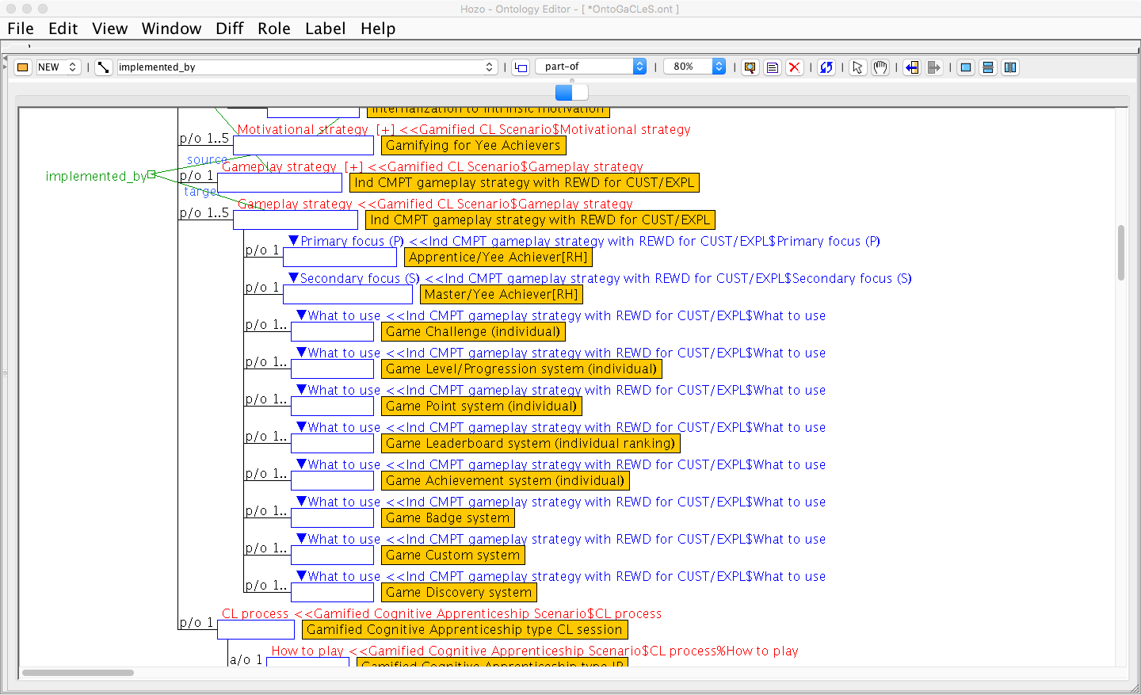

Slide 19
[ ]
Give advise
Motivated, Being familiar behavior
Reward strategy to be motivated and to make familiar behavior based on PSD
Promise reward
Raise motivation
Motivated
Await
Give advise
Being attentive
Give reward
Increase self-behavior
Being familiar behavior
Gameplay-stimulus
Gameplay-mechanics
Gameplay-consequence
Promise reward strategy by points
Suggestion strategy to be attentive based on PSD
Give reward strategy by points
Promise points
Receive promise of points
Has received the promise of points
Give points
Receive points
Has received points
Give suggestion
Focus attention
Being attentive
Await
Give advise
Gameplay-stimulus
Gameplay-mechanics
Give suggestion strategy by level
Show cond. to achieve next level
View cond. of next level
Has known cond. to achieve next level
SEMT/SUGG

Slide 20
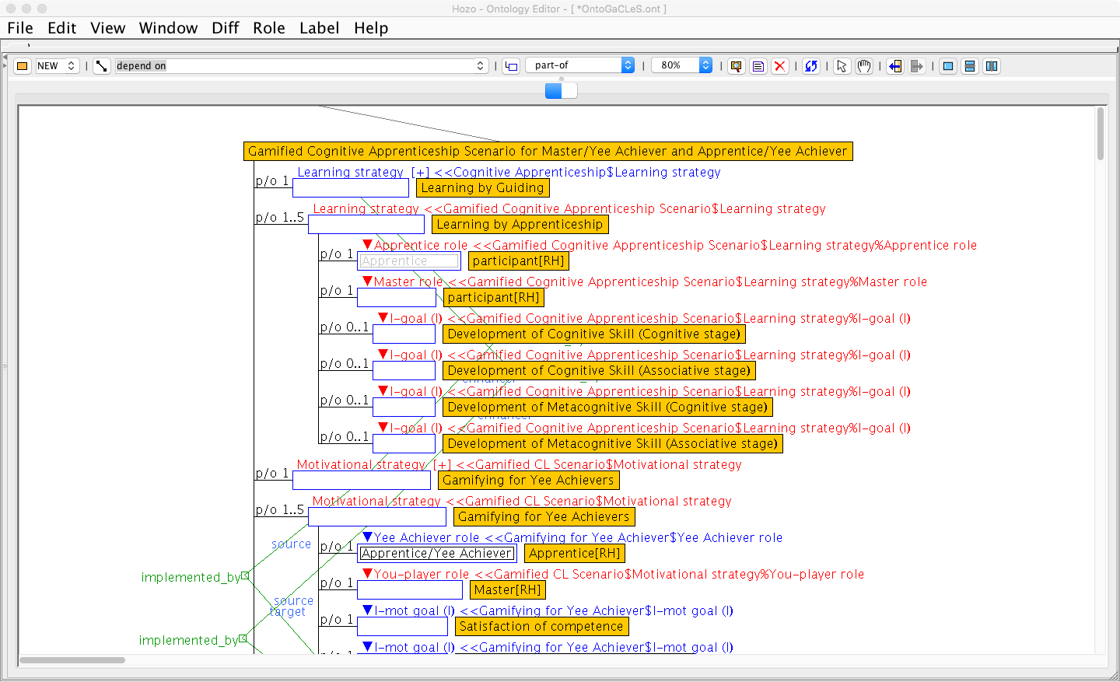
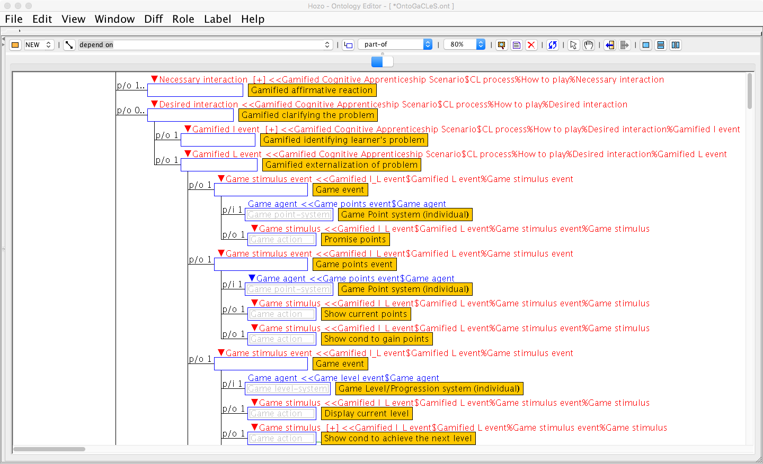
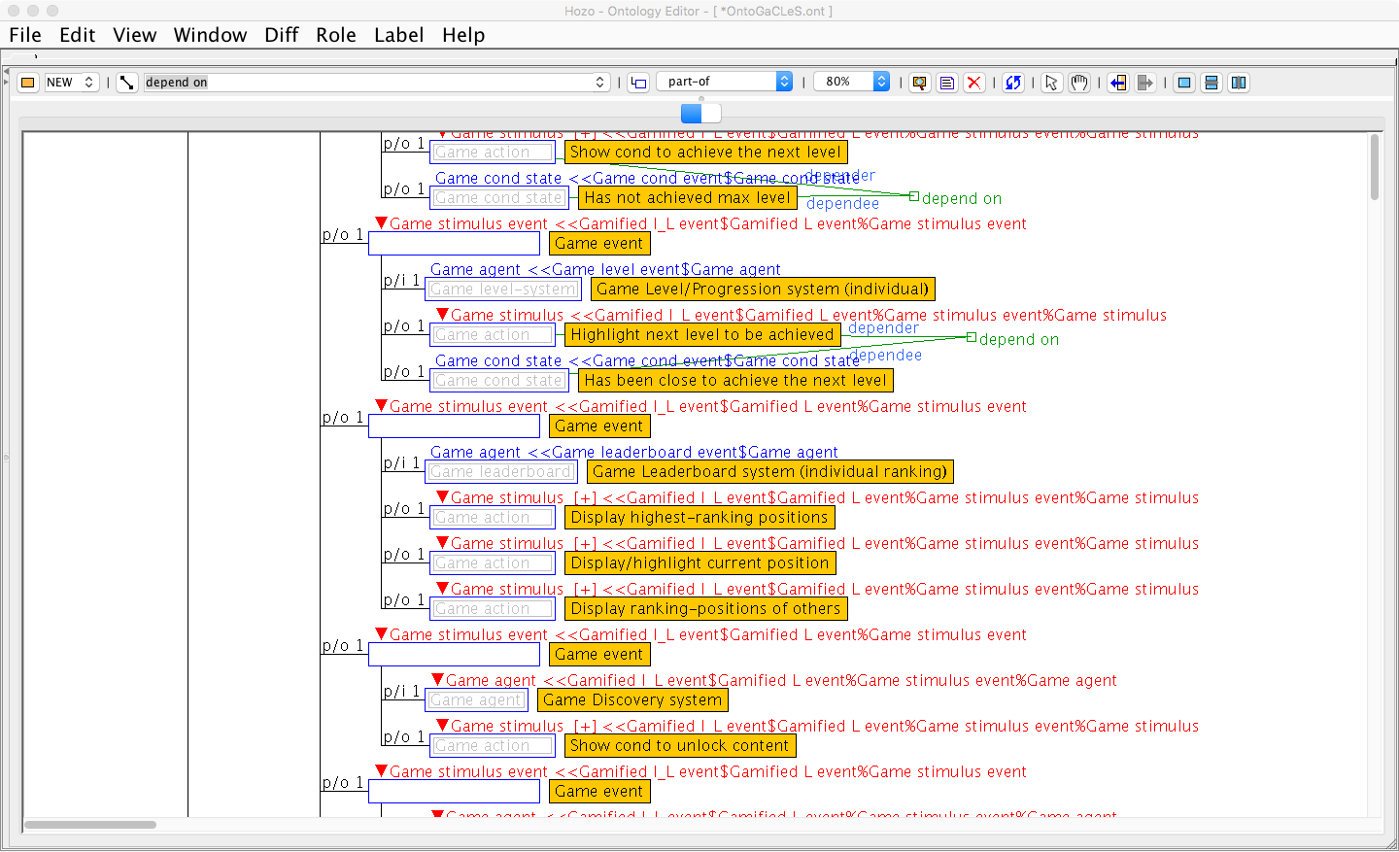
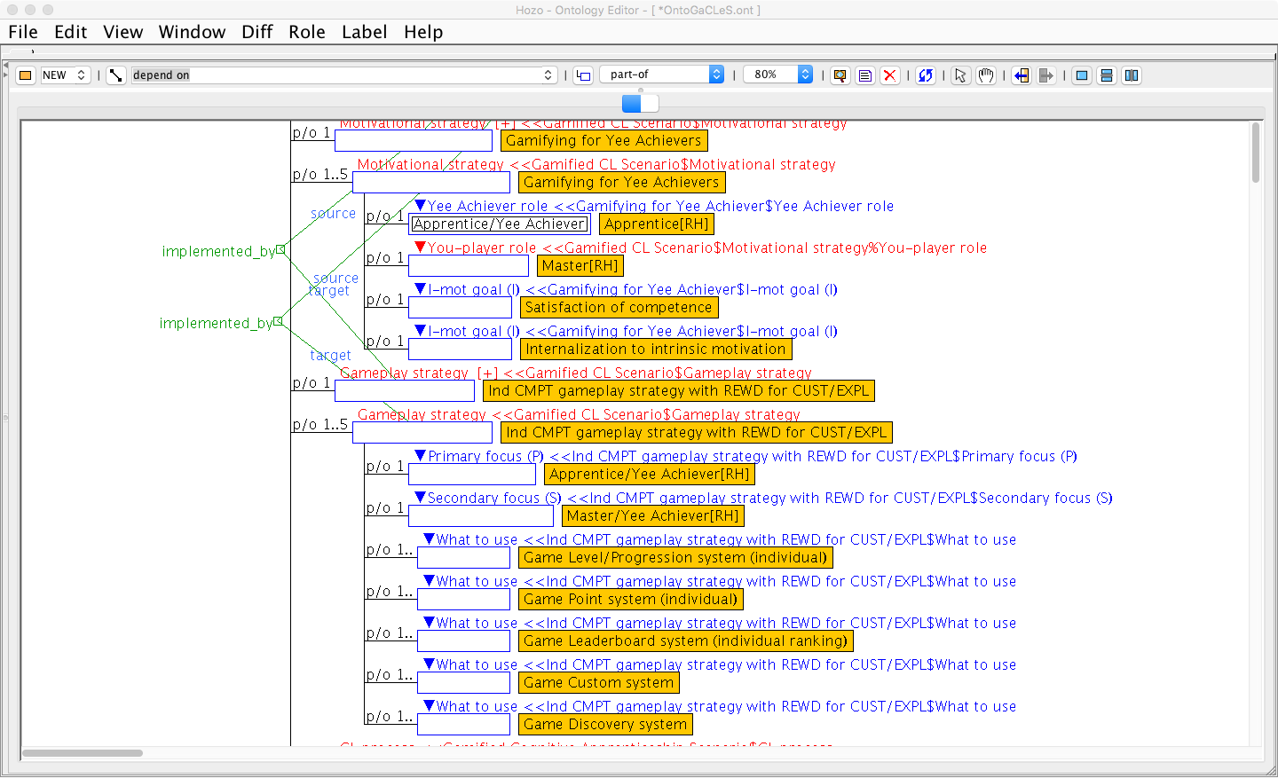
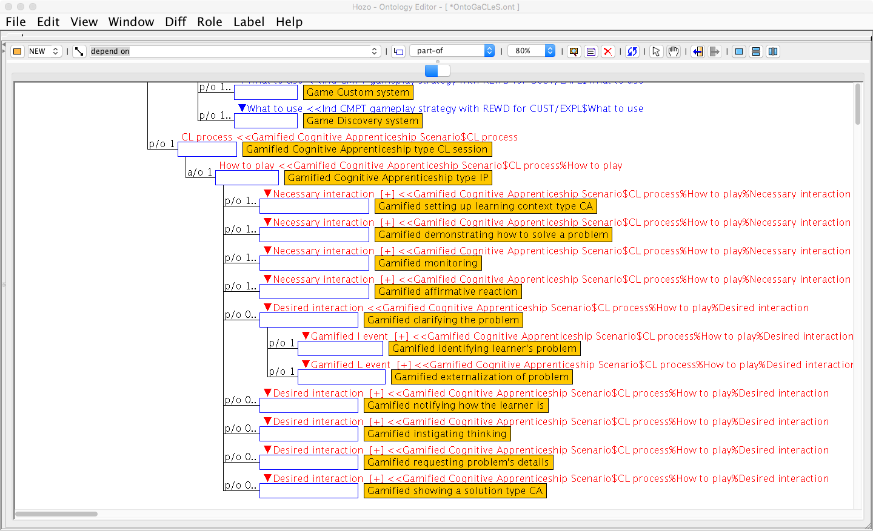
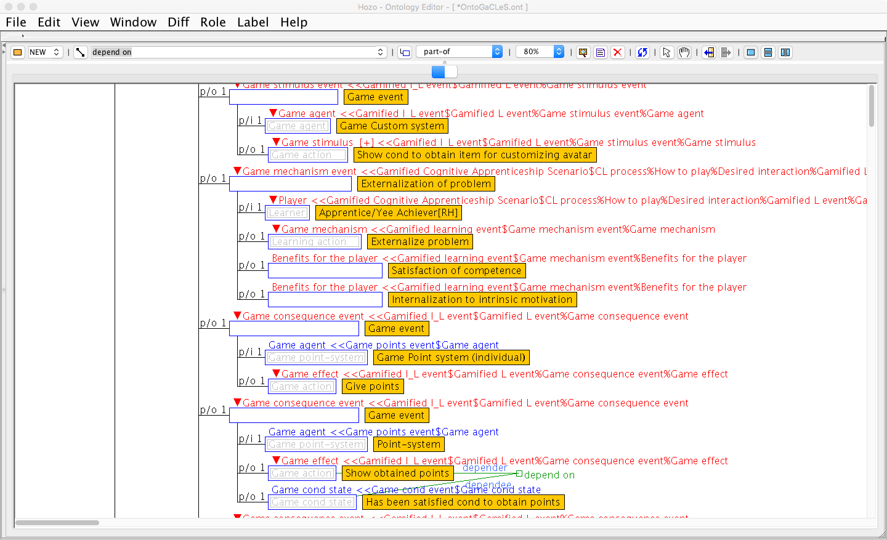
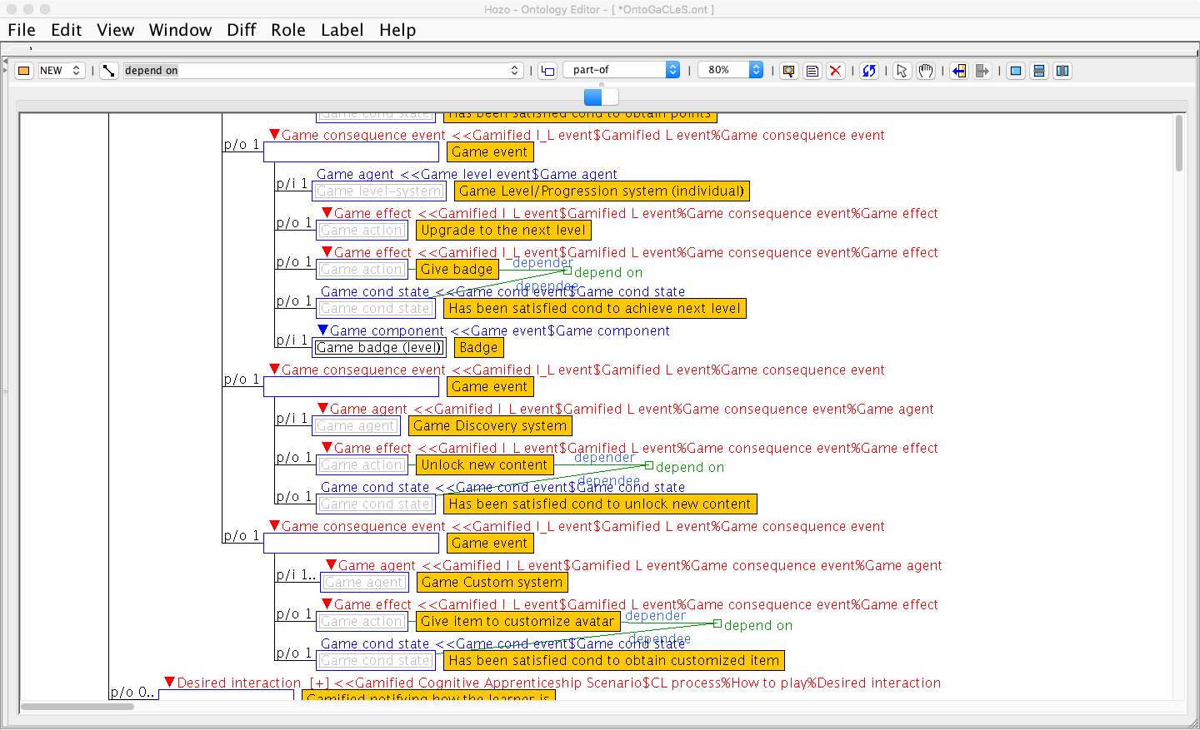
(A)
(B)
(C)
(D)
(E)
(F)
(G)
(A)
(B)
(C)
(F)
(G)

